Slide 1

Unit 4
Text A
National Oil companies： Oil’s Dark Secret

Slide 2
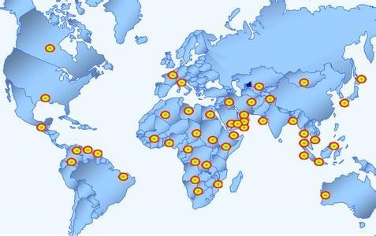
Section 2 text learning (A)
National Oil Companies: Oil’s Dark Secret
Text Organization
Information Analysis
Language Points
3. Theme Discussion
Notes:
背景图片名称：中国石油公司继续在“走出去”战略

Slide 3
Section 2 text learning (A)
Text Organization
Part 1 (Para. 1-?) ______________________
Part 2 (Para. ?-?) ______________________
… ?
How many parts can you divide the passage into?

Slide 4
Section 2 text learning (A)
Text Organization
Part1 （Para.1）：
Part2 （Para.2-7）：
Part3 （Para. 8-13）
Introduction to NOCs: definition, advantages and problems.
Problems in the national oil company.
In spite of the problems and failures in NOCS, some factors can help.

Slide 5
Section 2 text learning (A)
Information Analysis
Part 1 (Para. 1) : Introduction to NOCs: definition, advantages and problems.
1. What is national oil company?
National oil company (NOC) is partially or wholly state-owned firms through which governments retain the profits from oil production.
2. What are the similarities of most-owned firms?
They are prone to over-staffing, underinvestment, political interference and corruption.

Slide 6
Section 2 text learning (A)
Information Analysis
Part 2 (2-7): Problems in the national oil company.
3. Why is it said that PDVSA provides a cautionary tale of how bad they can be? (Para. 3&11)
President Hugo Chávez has forced most foreign oil firms in Venezuela to go into partnership with its national champion. It is now running the resulting joint ventures－presumably no better than it runs its original fields. (Para. 3)
Mr Chávez dictates the laying of pipelines of PDVSA and customers. (Para. 11)

Slide 7
Section 2 text learning (A)
Information Analysis
4. Why will oil production be more concentrated in
the hands of the national firms of Russia and the
Persian Gulf?
Persian Gulf in the future? (Para. 4)
---- decrease of oil production in the open areas
---- largely out of bounds to multinationals
---- not yet thoroughly raked over

Slide 8
Section 2 text learning (A)
Information Analysis
5. There are some reasons for the failure of
nationalization. What are they? （Para. 5-7）
---- excessive government intervention (over-staffed, instruments of foreign policy, frequently nationalized)（Para. 5）
---- a lack of openness (of enough data to a theory, a full picture of oil ) (Para. 6)
---- underinvestment (politically palatable to reduce drilling programs and seismic surveys) (Para. 7)

Slide 9
Section 2 text learning (A)
Information Analysis
Part 3 (Para. 8-13): In spite of the problems and failures in NOCS, some factors can help.
6. What leads to the inefficiency and corruption of
NOCs?
There are no enough strong institutions to regulate them or to manage the money they generate.

Slide 10
Section 2 text learning (A)
Information Analysis
7. What strategies can be helpful for the nationalization?
---- (Saudi Arabian) gradual and friendly takeover helps to preserve institutional memory and an efficient corporate culture. Otherwise …… (Para. 10)
---- Clear strategic guidance goes hand-in-hand with operational autonomy at the best NOCs. (Para. 11)
---- Competition also helps. (Pare. 12)
---- Abundant oil does not seem to be prerequisite to success for a NOC, but seems to do most state-run firms more harm than good. (Para. 13)

Slide 11
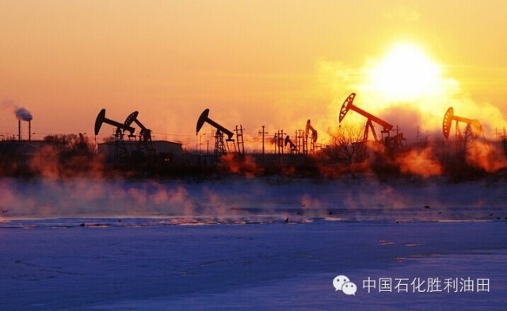
Section 2 text learning (A)
Theme Discussion
How do you understand “Abundant, inalienable oil, on the other hand, seems to do most state-run firms more harm than good”(Para. 13)?
2. China has several NOCs, such as PetroChina,
Sinopec. Do you have some suggestions on their
development?
Notes:
CNPC（ China National Petroleum Corporation ）； PetroChina

Slide 12
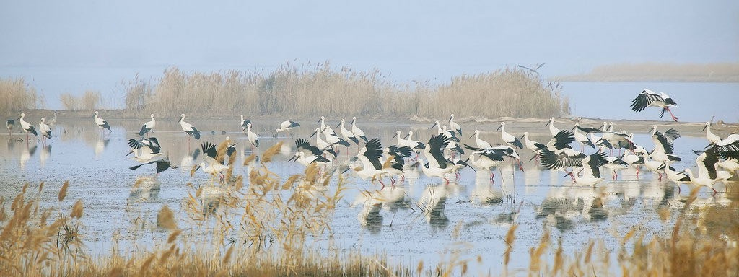
Section 2 text learning (A)
Theme Discussion
How do you understand “Abundant, inalienable oil, on the other hand, seems to do most state-run firms more harm than good” (Para. 13)?
Some countries waste money from oil on authority of the state. Without the effective control of the countries over NOCs, many problems will appear, such as inefficiency and corruption. In some areas, private-owned oil companies perform better. So nationalization of oil company is not always a good way to develop oil industry.

Slide 13
Section 2 text learning (A)
Theme Discussion
2. China has several NOCs, such as PetroChina, Sinopec，
and CNOOC. Do you have some suggestions on their development?
Chinese NOCs have similar problems to other countries’, eg., over-staffing, political interference and corruption.
Some experiences from other country’s NOCs deserve Chinese NOCs’ study (regulated by the country).
Permit the foreign investment on Chinese oil industry. Proper competition forces NOCs to keep costs down and methods up to date. The presence of multinationals also helps to develop a country’s pool of skilled labor and to disseminate new technology and ideas.
Notes:
PetroChina中国石油天然气股份有限公司（简称“中国石油”或“中石油”）Sinopec中国石油化工集团公司（简称“中国石化”或“中石化”，Sinopec Group）；CNOOC (China National Offshore Oil Corporation) 中国海洋石油总公司（简称“中国海油”），ConocoPhilips 美国康菲

Slide 14
Section 2 text learning(A)
Language Points
1）Because these national champions control ……the likes of Exxon to assuage the current worries about supply and influence the accompanying record prices. …… they are prone to over-staffing, underinvestment, political interference and corruption. (Para. 1)
be prone to sth.: to have a tendency to be affected by it or to do it 有…倾向，易于
Cf. be liable to; be apt to
由于这些国有巨头们控制了世界上大约90％的石油和天然气，因此相比埃克森之类的公司，他们更易于缓和现在对石油供应的焦虑，并影响相应的创纪录高价。但是和大多数国有公司一样，它们也容易有各种弊端：人员过剩，投资不足，政治干涉以及腐败。

Slide 15
Section 2 text learning(A)
Language Points
2) It is now running the resulting joint ventures —
presumably no better than it runs its original
fields. (Para. 3）
它现在经营了许多合资公司——大概并不会比它原先经营的油田好到哪去。
3) New oil is most likely to be found in the NOCs’
territory, precisely because it is largely out of
bounds to multinationals such as …… and so has
not yet been thoroughly raked over. (Para. 4)
由于禁止像埃克森美孚公司和英国石油公司这样的跨国公司的介入，这些地方还没有被完全开发，因而新的油田最有可能在国有石油公司的领土上被发现。

Slide 16
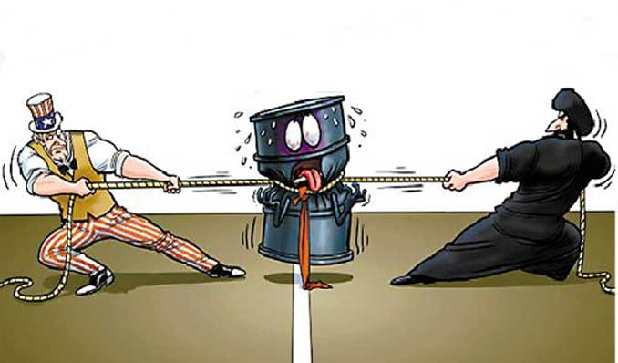
Section 2 text learning (A)
Language Points
4) Saudi Aramco has not released enough data to quash a theory that its oil reserves are not nearly as large as it contends, and that its output may have peaked. (Para. 6)
有一种理论认为沙特国家石油公司（也叫沙特阿美，全称Arabian-American Oil Company）的实际石油储备量并没有其声称的那样多，而且它的产量已经达到了顶峰，但是沙特石油公司未能提供足够的数据来反驳这理论。

Slide 17
Section 2 text learning (A)
Language Points
5) Any government that relies on oil in general, and a state-run oil firm in particular, for the majority of its income, is likely to skimp on investment when the oil price falls, because it is more politically palatable to slash drilling programmes and seismic survey than civil servants’ salaries and hospital budgets. (Para. 7)
任何总体上依赖石油，特别是依赖一个国有石油公司获得大部分收入的政府，在石油价格下跌的时候都会倾向于缩减投资，因为相对于削减公务员的薪水和医院预算来说，大量减少钻探项目和地质调查在政治上更易于接受。

Slide 18
Section 2 text learning(A)
Language Points
6) So NOCs sprang up before their countries had institutions strong enough to regulate them, or to manage the money they generate — a recipe for inefficiency and corruption. (Para. 8)
这些公司得以快速发展，然而政府还没有足够健全的体制对其实施监管，也不能妥善管理公司财富，这正是导致公司运营低效和管理腐败的原因。

Slide 19
Section 2 text learning(A)
Language Points
7) By contrast, Sonatrach took over foreign oil firms’ assets in
Algeria much more abruptly and acrimoniously, following
a long and bitterly fought war of independence. (Para. 10)
相比之下，阿尔及利亚国家石油公司Sonatrach则以一种更加生硬刻薄的方式接管了外国石油公司的财产，接下来又陷入了漫长而残酷的独立战争。

Slide 20
Section 2 text learning(A)
Language Points
8) But clear strategic guidance, Miss Marcel argues, goes hand in hand with operational autonomy an the best NOCs. The Saudi government, for example, lets Aramco set its own prices, unlike Kuwait’s, which hands them down to KPC from on high. (Para. 11)
但Marcel女士认为，最优秀的国家石油公司，不仅需要清晰的战略方针，还应当享有企业的自主经营权，两者并行不悖。例如，沙特政府就允许阿美石油公司自行设定石油价格，而不像科威特政府那样将定价下达给KPC。

Slide 21
Section 2 text learning(A)
Language Points
9) Critically, Aramco is able to retain a portion of its earnings for maintenance and expansion, rather than subsisting on an allocation form the national budget, as Iran’s state-run oil firm did until recently. (Para. 11)
10) The presence of multinationals also helps to develop a country’s pool of skilled labour and, when they operate in joint ventures, to disseminate new technology and ideas. (Para. 12)
更重要的是，沙特阿美能够保留一部分收入用于公司的日常运作和发展，而不是依靠国家预算的划拨来维持生存。而直到现在，这一直是伊朗国家石油公司赖以生存的方式。
跨国公司的存在也帮助培养了一大批技术熟练的劳动力，并且当他们在合资企业中工作时也传播了新技术和新观念。

Slide 22

Section 3 Exercises
Language
Oral Presentation
Translation
Essay Writing

Slide 23
Section 3 Exercises
Language
Task 1 Glossary Match
c 2. d 3. g 4. a 5. h 6. b 7. e 8. f
Task 2 Words or Expressions
1. are prone to 6. potential
2. reserve 7. incentive
3. Feasible 8. presumably
4. Abundance 9. dictate
5. Diversification 10 undermine

Slide 24
Section 3 Exercises
Oral Presentation
Task 1 Questions and Answers
Answer the following questions according to the information from Text A, B or C.
Question 1. Paragraph 11 & 12 of text A
Question 2. Paragraph 5 of text B
Question 3. Paragraph 2-5 of text B
Question 4. Paragraph 7 of text C
Question 5. Paragraphs 2-11 of text C

Slide 25
Section 3 Exercises
Oral Presentation
Task 3 Critical Thinking Enhancement
The benefits of all that cheap crude oil still haven’t shown up at the one place it matters most: the gas station. Simple economics suggests that higher supplies and lower demand should translate into cheaper prices. But abundant oil hasn’t cut gasoline prices. There are many reasons. For example, regulatory and transportation systems that grew out of those old assumptions have become increasingly outdated, preventing the forces of supply and demand from working efficiently. To bring gasoline prices way down requires improvements in the pipeline, barge, and truck network. Yet even with improvements in oil-field logistics, drivers will be competing for gasoline with their counterparts elsewhere in the world.

Slide 26
Section 3 Exercises
Translation
Task 1 Translate the following sentences into Chinese.
1. 任何以石油为经济支柱的政府，尤其那些经济收入依赖国有石油公司的政府，在石油价格下跌的时候，都会倾向于缩减投资；因为相对于公务员的薪水和医院预算来说，大幅削减钻探项目和地质调查在政治上更容易让人接受。(Text A, Para. 7)
2. 尽管欧佩克历来被当作抬高油价或禁运石油出口的政治工具——这点从2008年油价飙升就可见一斑，但是该组织现在面临的挑战是关于如何石油合理的低价，而不是人为抬高油价或者禁运石油。(Text B, Para. 9)

Slide 27
Section 3 Exercises
Translation
3.与其担心那些坏脾气的石油大国，不如做好准备迎接新的地缘政治格局：原先的蒸蒸日上的可能会走下坡路，而那些从前在众人心中毫无地位的国家也许会成为全球的重要玩家。(Text C, Para. 2)
4. 对于美国来说，这真是天大的好事。花旗集团的埃德•莫尔斯欣喜若狂地说：“美国不会再向暴君们或封建君主们卑躬屈膝了，他们的石油供应已不再是外交政策的筹码。”这个说法可能有一点儿盲目乐观，不过我们对此也有个大致了解。(Text C, Para. 5)
5. 和石化能源公司相比，绿色能源公司的发展障碍本身就大；当石油、天然气价格下降以后，遇到的阻碍将更增大。不过，仍有一线希望：它们不会就此被市场淘汰，低廉的能源价格会带给消费者新的选择。（Text C, Para. 10）

Slide 28
Section 3 Exercises
Translation
Task 2 Translate the following paragraph into English.
The internalization of national oil companies is among the top trends on the global energy front in the 21st century. It occupies available energy of western international oil companies. Moreover, the competitive landscape shifts: OPEC members are much diminished; globally, new oil-and-gas suppliers, such as U.S. shale oil and gas potential, Canada’s oil sands, Venezuela’s ultra-heavy oil and Brazil’s deep-sea oil are emerging. Chinese state-owned oil companies have considerable advantages in funds, certain technologies and services. However, compared with western international oil giants, they still fall behind owing to an insufficiency in global management and supporting research.

Slide 29
Section 3 Exercises
Essay Writing
Please write a report with about 4oo words on the basis of the information on page 78 and the following suggested outline.
The suggested outline for this article:
Brief introduction to the report by global energy consultancy Wood Mackenzie.
The importance of oil import to Chinese economic well-being.
The present situation of Chinese external competitiveness in terms of crude oil importing in the age of oil abundance.
The measures for China to improve its external competitiveness.

Slide 30
Section 3 Exercises
Essay Writing
Information for the writing:
1) China to leapfrog US in oil imports by 2017
http://www.chinadaily.com.cn/business/2013-08/22/content_16912568.htm
2) Nation tipped to be largest oil importer
http://www.chinadaily.com.cn/business/2013-11/28/content_17136368.htm
3) The Role of Energy in Economic Growth
http://www.theoildrum.com/node/8476
4) China depends more on overseas oil
http://www.chinadaily.com.cn/china/2013-04/08/content_16384493.htm
5) China's crude oil external dependences
http://wenku.baidu.com/link?url=6n4bLcItIEni3fWjH9J6b5BhxbqaOfsPPJ74JKQSn1GMXiVLZO3UhfQTzsO_eLZED_6KqXxsjnIweymFOyo749BlF9k90Rvh56mVrNtXO-G
6) Arab oil firms go prospecting in Chinese market
http://www.chinadaily.com.cn/business/2012-09/18/content_15764976.htm
7) Motivations and strategies for overseas investment
http://doc.mbalib.com/view/d4c0508124b2da5bb28c8e8b42f8a166.html

